Slide 1
Large Countries and Biodiversity Conservation: China as Compared to the United States
Jerry McBeath & Bo Wang
UAF & UIBE
For presentation at the 2016 AACS

Slide 3
Overview
A comparison of cases both similar and dissimilar
China and US are similar in size and expanse of territory; world’s largest economies; large environmental footprints
Dissimilar in system type, role of law, traditional thought systems

Slide 5
The Problem: Species Losses
Both China and the U.S. are mega-diverse countries
In past, China’s species threatened by transformation of land toward agriculture (and deforestation); in the U.S. the chief cause of species loss was over-exploitation—e.g. extinction of American bison and passenger pigeon

Slide 6
Problem (cont.)
Today, major cause in China is over-exploitation, followed by habitat destruction, pollution, invasives and diseases;
In U.S., habitat destruction (ag., logging, oil/gas) is prime cause folllowed by invasives, pollutin and diseases.
Climate change challenges both China and U.S.

Slide 8
Socio-cultural Differences
China’s dynasties established an hierarchical imperial system, reigning until the “century of humiliation,” which prompted a catch-up mentality,” and attitude of “first get rich, then get clean.”
U.S. is a young nation, settled by Europeans seeking liberty and wealth. By late 19th century, however, support grew to preserve environmental treasures, and U.S. became an environmental pioneer

Slide 9
Socio-cult. (cont.)
Cultural and market conditions varied as well.
In the U.S., wildlife and nature were objectified, treated as an “other” and in cases sanctified
In China, wildlife and nature were part of the universe, of tianrenheyi. However, Chinese used animals/plants for medicines, raw materials for artisans, and exotic foods—leading to the largest illegal trade in wildlife products in the world

Slide 11
The Law and Legal Culture
At the start, U.S. states protected wildlife through law and regulations; then in 1973, through an expansion of the interstate commerce clause, Congress enacted the Endangered Species Act (ESA), identifying threatened/endangered species, establishing a consultation process and attempting recovery
Ancillary legislation include NEPA, Clean Water Act, Clean Air Act and other “command-and-control” type laws

Slide 13
Law (cont.)
China is more a “rule by law” than “rule of law” state.
Yet the National People’s Conference enacted the Wildlife Protection Law (1988); the State Council promulgates regulations; ministries engage in endangered species protection work;
Overall, there’s a clear difference between the U.S. legalistic approach and that in China, focused more on relationships

Slide 14
Protected Areas (PAs): The Landscape of Species Protection
The U.S. has the world’s oldest park (Yellowstone), set up in 1872. Wilderness Act of 1964 classified all federal territory, including refugees, parks, wilderness area with protective status.
U.S. states also have established parks, reserves, and refuges
Overall, the approximate amount of U.S. land in protected status is 14 percent

Slide 16
PAs (cont.)
China’s first park was established in 1954
China divides PAs into national, provincial, county and township with movement from bottom up
China’s PAs formally exceed 15 percent of territory
Both nations are criticized for having “paper parks;” but there are more in China than U.S.

Slide 17
Administrative/Implementation Systems
A) number of agencies range from simple (US with just two, USFWS & NMFS) to complex (China has nearly 10 agencies responsible for PAs alone.
B) The U.S. constitutionally is a federal system, while China has a decentralized system, with growing power at local levels but not quite autonomous

Slide 18
Learn more at Uploaded

Slide 19
Admin/Impl. (cont.)
The Chinese system until recently has been top-down
The U.S. emphasizes grassroots involvement
Public participation may be enshrined in China’s EIA system, but the role of NGOs has been curbed
Definitely, the U.S. has a more robust civil society than China, which influences policy implementation

Slide 20
Comparative Evaluations
U.S. follows a law-based approach to species protection; this does not allow economic or other considerations to intrude on decision-making
Species (but not ecosystems) are protected
Yet there’s no prioritization scheme; listing criteria are vague; animals (esp. charismatic ones) are valued over plants

Slide 22
Comp. eval (cont.)
Of U.S. listed species (around 1,500), just 1 % have become extinct; recovery rate exceeds 90 % in 43 year history of ESA
Critical habitats have been designated, increasing protection
China, on the other hand, follows a relational (could be called “cultural”) approach to endangered species protection

Slide 23
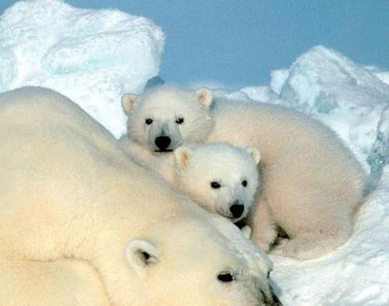
Pictures and Images >> Polar Bear
Add to Phobia Filter | Contribute | Original Image | Listen

Slide 24
Comp. eval. (cont.)
Multiple agencies with conflicting agendas are involved in endangered species work
China, like other LDCs, is criticized for its “implementation deficit” in environmental protection work
Yet the cadre evaluation system now includes an environmental protection emphasis; potentially this will increase uniformity and effectiveness of the enforcement regime

Slide 25
Conclusion
China and U.S. are similar in size and env. footprint, but have different political, legal, economic and social systems
These lead to contrasting approaches to biodiversity conservation, as we would expect
Law-based systems have their strengths, but their cost is quite high
Contradictory, agency-based approaches are complex, emphasize political and personal relationships, and seem anti-scientific

Slide 26
Conclusions (cont.)
However, the Chinese system is evolving
Scientists have played major roles in some areas (as have foreign experts and NGOs)
Recent leaders (e.g. Xi Jinping) pay more attention to environmental concerns; seem willing to allocate more resources to them
There are some grounds for hope

Slide 27
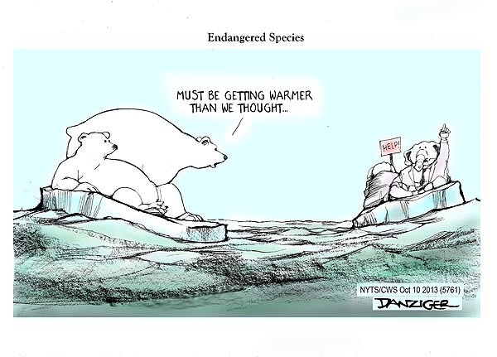

Slide 28
THANKS!
You’ve been polite and attentive.
Now it’s time for your questions!

